Slide 1
BIG 3 Making Homework Work

Slide 2
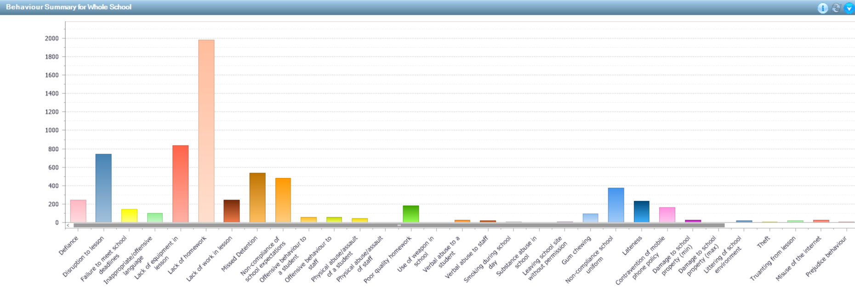
Homework at DHFS
Homework accounts for the most behaviour points within DHFS
From Sept – May there were 2148 incidents of lack of homework
Approx. 623 different students had a behaviour point for lack of homework.

Slide 3
Current concerns
Accuracy of recording homework, all students are not on a level playing field
Absences from lessons and the impact on homework
TA support in recording homework
Time used in lesson for recording homework
Issues in students organisation and the impact on homework
Limited reliability when monitoring homework as a house team
No current electronic monitoring system for monitoring homework for Curriculum Leaders, HPLs or SLT. Therefore it is difficult to identify factual trends
Parents reliant on the student in order to provide support their child or challenge them when it has not been completed
Parents have limited feedback from staff other than behaviour / achievement points

Slide 4
Homework - SIMs The Trial

Slide 5
The Trial
The trial has been running for approx. 13 weeks.
Technology / 3 staff / Year 9 students.
Staff have been setting homework using SIMS as a platform.
Trial highlighted an increase in homework from students.
Feedback from parents and carers outlined a positive impact on the ability to support students.
Due to the success and the increase in homework completed within this cohort we will be moving to an electronic based system.

Slide 6
The Process
Staff training
10th June
Y10 training in
mentor time
w/c 10th June
Y7-9 training
in ICT lessons
Y12 training in
futures lessons
w/c 17th June
Launch of SIMS homework
24th June
New Y7/12 to be trained in Sept
All parents and carers are informed through letter/email/text

Slide 7
Setting Homework Training

Slide 8
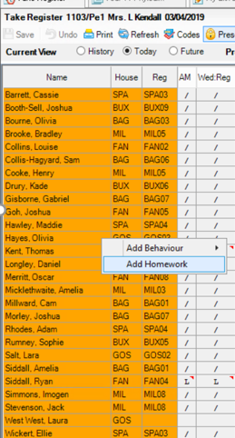
Setting homework
From a register
Click on the top student
CTL A – to select all
(to unselect anyone hold CTL and click)
Right click – Add Homework
Notes:
This is what we expect, OUR commitment to you and your parents/carers, this is our day to day business. Committed staff body. Vast majority of our students contribute positively to achieving this

Slide 9
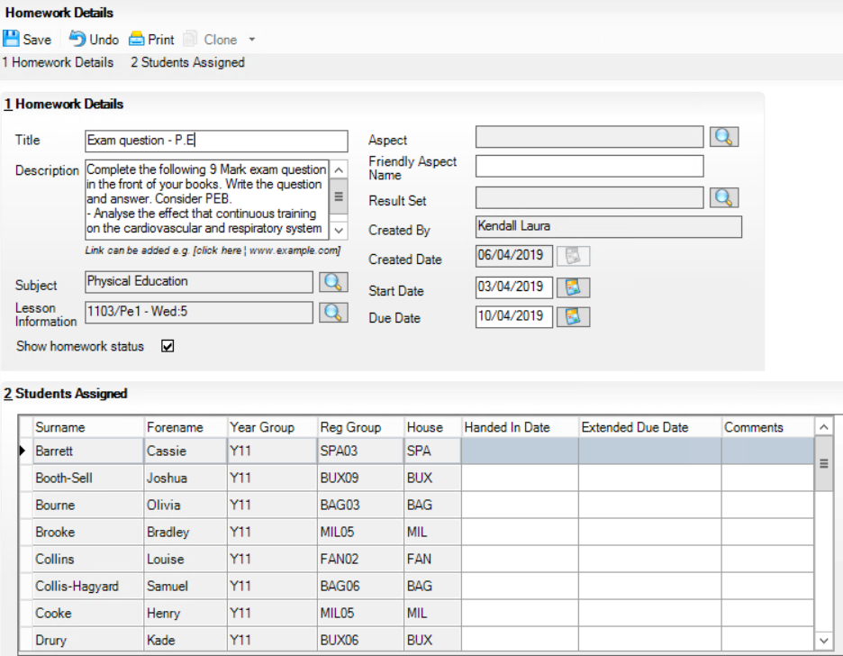
1. Add a title
4. Click Save
2. Add detail of the homework
3. Input start date and due date
Notes:
This is what we expect, OUR commitment to you and your parents/carers, this is our day to day business. Committed staff body. Vast majority of our students contribute positively to achieving this

Slide 10
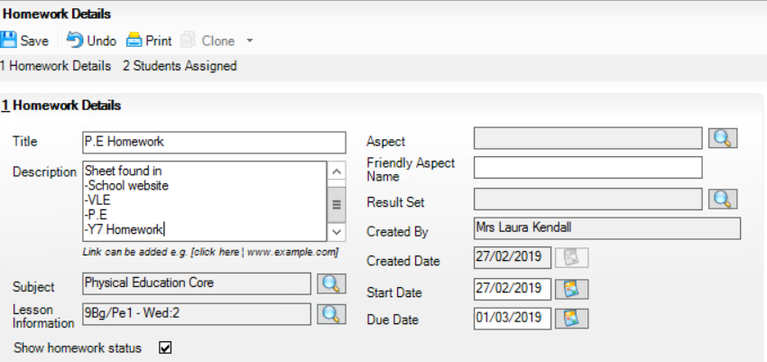
Highlight where in the VLE (or other area) the sheet is kept or type on the website. Resources can still be handed out as hard copies in class.
Adding a worksheet/attachment
Use this code to add a clickable hyperlink to the homework description.
[click here ¦ wwww.example.com]
e.g. to a page on the VLE, or to an online resource
Notes:
This is what we expect, OUR commitment to you and your parents/carers, this is our day to day business. Committed staff body. Vast majority of our students contribute positively to achieving this

Slide 11
Editing Homework

Slide 12
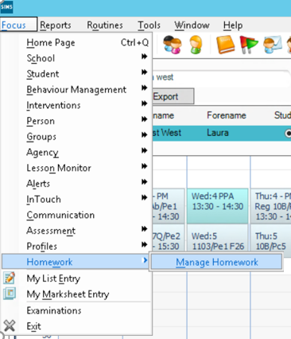
Editing and monitoring homework
Click:
Focus
Homework
Manage Homework
Notes:
This is what we expect, OUR commitment to you and your parents/carers, this is our day to day business. Committed staff body. Vast majority of our students contribute positively to achieving this

Slide 13
4) Search
Monitoring homework
1) Select
Staff
3) Start date/ due date
Change dates to identify past and future homework
2) Date search type:
None – see all homework set
Due on – see specific dates
Start on – see specific dates
In progress between – see homework between dates
Notes:
This is what we expect, OUR commitment to you and your parents/carers, this is our day to day business. Committed staff body. Vast majority of our students contribute positively to achieving this

Slide 14
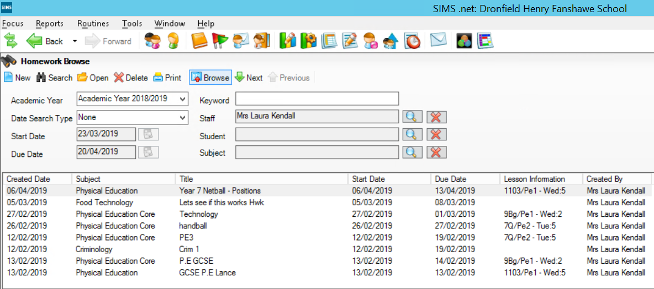
Editing homework set
Double click on the homework you want to edit
Notes:
This is what we expect, OUR commitment to you and your parents/carers, this is our day to day business. Committed staff body. Vast majority of our students contribute positively to achieving this

Slide 15
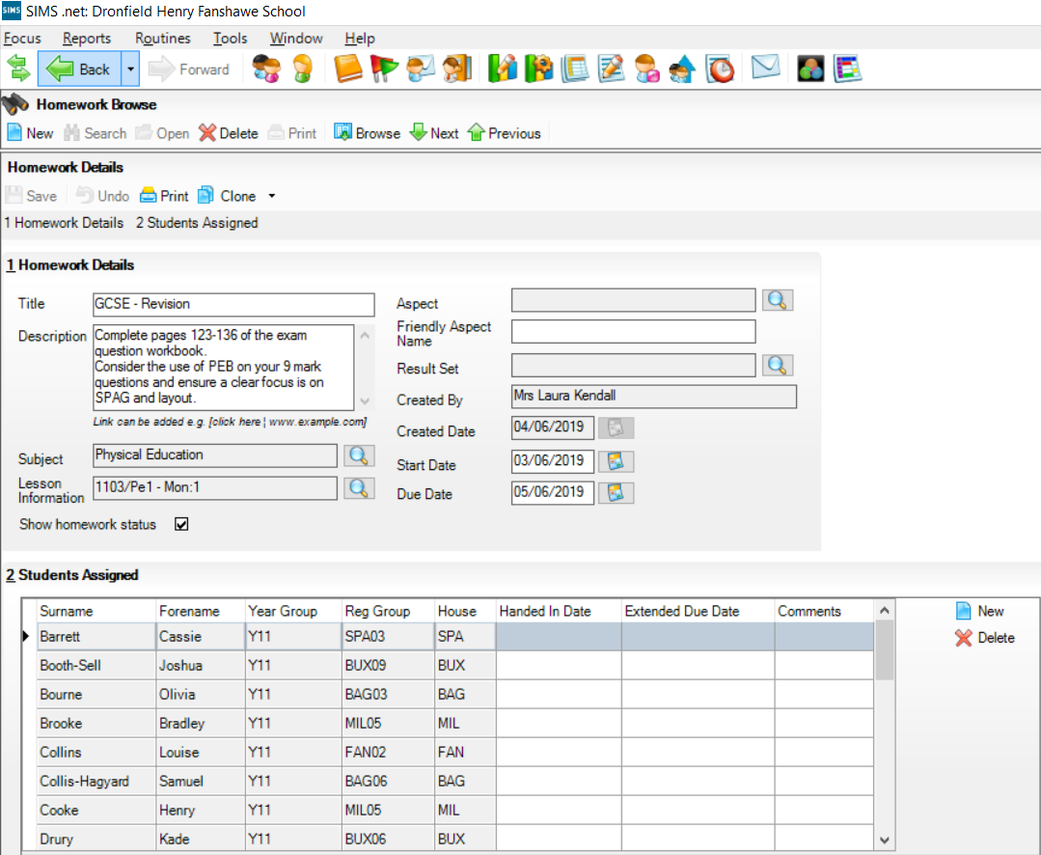
Edit work and click save
Editing homework set
Delete the homework completely
Delete/Add a student from the homework
Notes:
This is what we expect, OUR commitment to you and your parents/carers, this is our day to day business. Committed staff body. Vast majority of our students contribute positively to achieving this

Slide 16
Assessing Homework

Slide 17
Assessing homework
Click:
Focus
Homework
Manage Homework
Notes:
This is what we expect, OUR commitment to you and your parents/carers, this is our day to day business. Committed staff body. Vast majority of our students contribute positively to achieving this

Slide 18
Assessing homework
To select all CTL A
2) Type in handed in date by clicking the top students box (right hand corner)
3) OPTIONAL - Has an extension date been given?
4) OPTIONAL - Any comments you wish parents, carers or students to see?
e.g. - Not enough detail
e.g. - 8/10 in test
5)Click Save
Notes:
This is what we expect, OUR commitment to you and your parents/carers, this is our day to day business. Committed staff body. Vast majority of our students contribute positively to achieving this

Slide 19
Working with a student as a mentor

Slide 20
Monitoring homework
Click:
Focus
Homework
Manage Homework
Notes:
This is what we expect, OUR commitment to you and your parents/carers, this is our day to day business. Committed staff body. Vast majority of our students contribute positively to achieving this

Slide 21
4)Search
Monitoring homework
Delete staff
Search for student
3) Start Date/ Due date
Change dates to identify past and future homework
2) Date search type:
None – see all homework set
Due on – see specific dates
Start on – see specific dates
In progress between – see homework between dates
Notes:
This is what we expect, OUR commitment to you and your parents/carers, this is our day to day business. Committed staff body. Vast majority of our students contribute positively to achieving this

Slide 22
What parents, carers and students see…

Slide 23
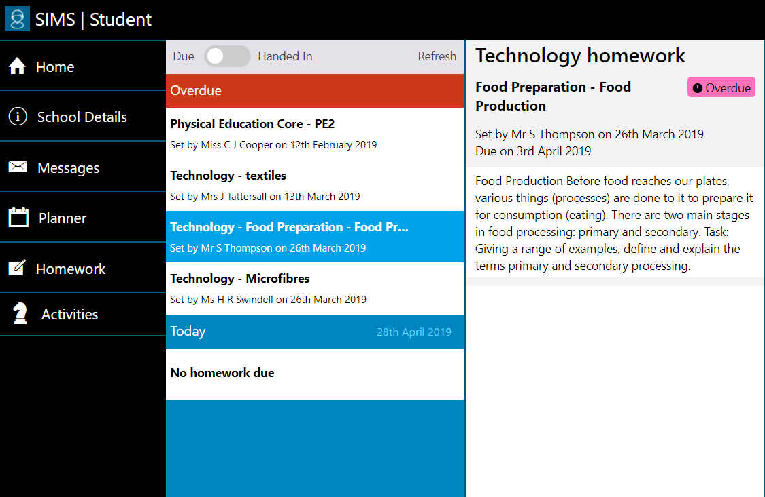
Students can see Homework:
Handed in / Due
What students see
Notes:
This is what we expect, OUR commitment to you and your parents/carers, this is our day to day business. Committed staff body. Vast majority of our students contribute positively to achieving this

Slide 24
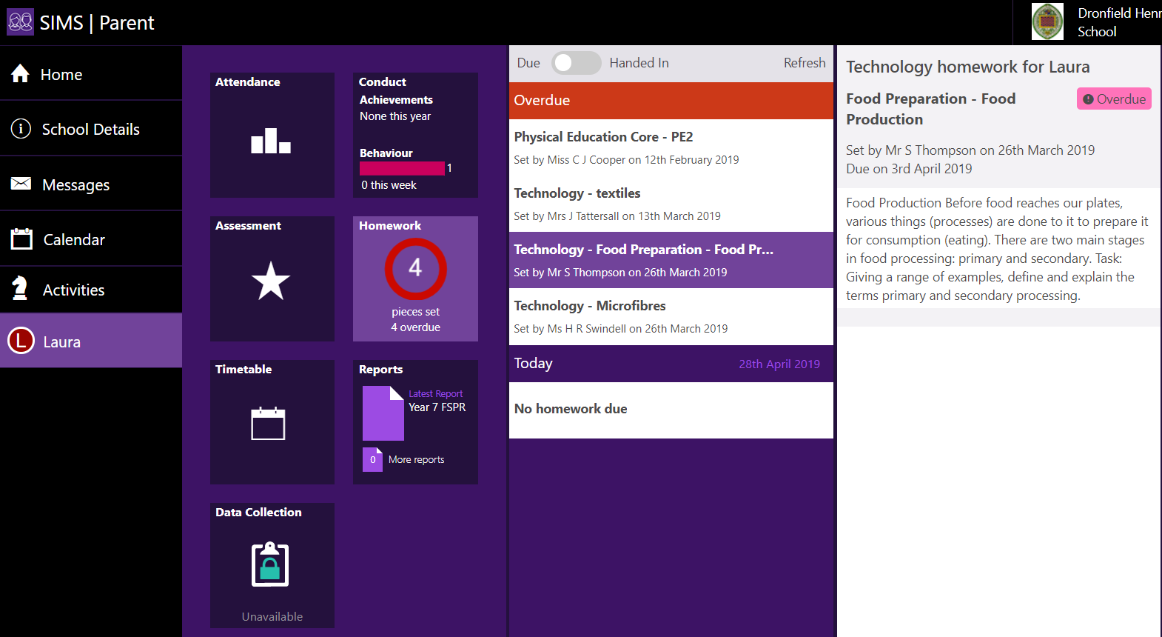
Parents and carers can see Homework:
Handed in / Due
What parents and carers see
Notes:
This is what we expect, OUR commitment to you and your parents/carers, this is our day to day business. Committed staff body. Vast majority of our students contribute positively to achieving this

Slide 25
FAQ

Slide 26
FAQ | Answers
How do I add a link? | Just type the link into the homework description. To make it a clickable hyperlink, use the code [click here ¦ www.example.com
How quickly does the system show the homework to the parents, carers and students? | Approx. 25 min.
Are parents able to see the homework? | Any parent who has registered with SIMS can see exactly what the student see.
Do behaviour points link straight from an overdue homework? | No. Any achievement/behaviour points and detentions have to be added separately.
When do ‘due date’ change to ‘overdue’? | If a student’s work hasn’t been marked as ‘Handed in’ and the deadline passes then it will show as ‘Overdue’ therefore staff must be prompt in changing this when students hand in homework.
Can comments be added later? | Yes. As long as the student’s work has been ‘handed in’ the work can be marked at a later date with comments added to inform parents or carers if you wish.
Notes:
This is what we expect, OUR commitment to you and your parents/carers, this is our day to day business. Committed staff body. Vast majority of our students contribute positively to achieving this

Slide 27
FAQ | Answers
What about planners? | As the planners are have a multi-use and to combat any issues all students will continue to have a planner for 2019-2020.
I feel I need further training. | Drop in sessions are available on: Thursday 13th June 12.30-1.00pm in D4 Tuesday 18th June 12.30-1.00pm in D4
Is there any way of saving documents? | Your Curriculum Leader will discuss the use of the VLE or other methods for this within your department. The VLE is accessible to students and parents.
What if a parent contacts me and cannot log in? | Please direct them to CCO who will reissue the log on details.
What if students need further training? | WC 24th June House assemblies will focus on SIMS homework. Additional training/support will be taking place at lunchtime this week for students.
Notes:
This is what we expect, OUR commitment to you and your parents/carers, this is our day to day business. Committed staff body. Vast majority of our students contribute positively to achieving this

Slide 28
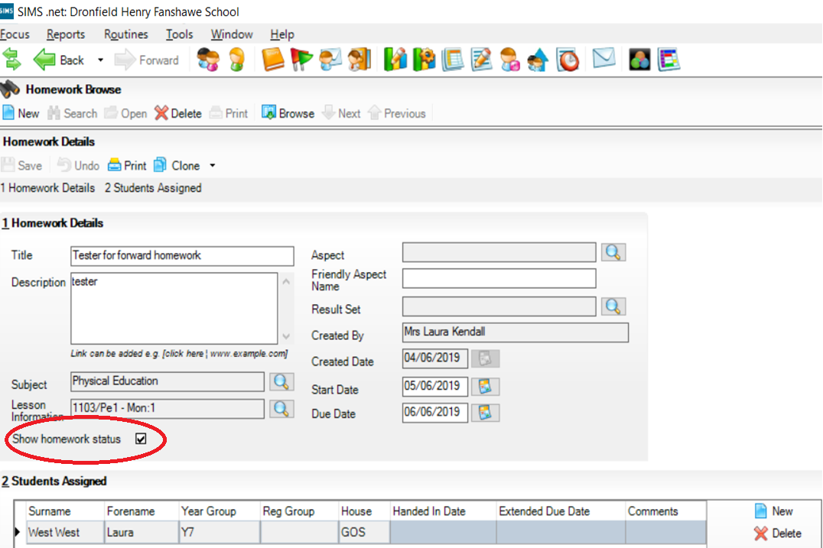
Important
Please can all staff ensure they do not de-select the ‘show homework status’ box.

