Slide 1
Your summer tasks…
Read a tragedy text and a crime text from the recommended list in the next slides.
Be ready to discuss this in class in September.
ASPIRE
Find an interesting video on the subject on Massolit or an article on Emag and be prepared to share with the class in September.

Slide 2
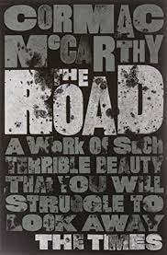
Summer Reading
Aspects of Tragedy
The Great Gatsby – F. Scott Fitzgerald
The Virgin Suicides – Jeffrey Eugenides
The Road – Cormac McCarthy
The Mill on the Floss –George Eliot
Jude the Obscure – Thomas Hardy
Germinal – Emile Zola
The Remains of the Day – Kazuo Ishiguro
Homegoing – Yaa Gyasi
The Duchess of Malfi (drama) John Webster
A Streetcar Named Desire (drama) Tennessee Williams

Slide 3
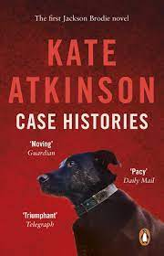
Summer Reading
Elements of Crime Writing
The Woman in White – Wilkie Collins
Sherlock Holmes – Arthur Conan Doyle
The Cuckoo’s Calling – Robert Galbraith (J.K.Rowling)
Miss Marple Agatha Christie
Rebus series - Iain Rankin
Tom Thorne series – Mark Billingham
Val McDermid
Raymond Chandler
Ruth Rendell

