Slide 1
Homework

Slide 2
Connecting to School StudentApp
The following are instructions on how to register your school logon details with School StudentApp.
You will receive an invitation email to your school email account. It will look similar to the one on the next slide. You must click on the ‘click this link’ hyperlink. This will open a browser window.
Notes:
This is what we expect, OUR commitment to you and your parents/carers, this is our day to day business. Committed staff body. Vast majority of our students contribute positively to achieving this

Slide 3
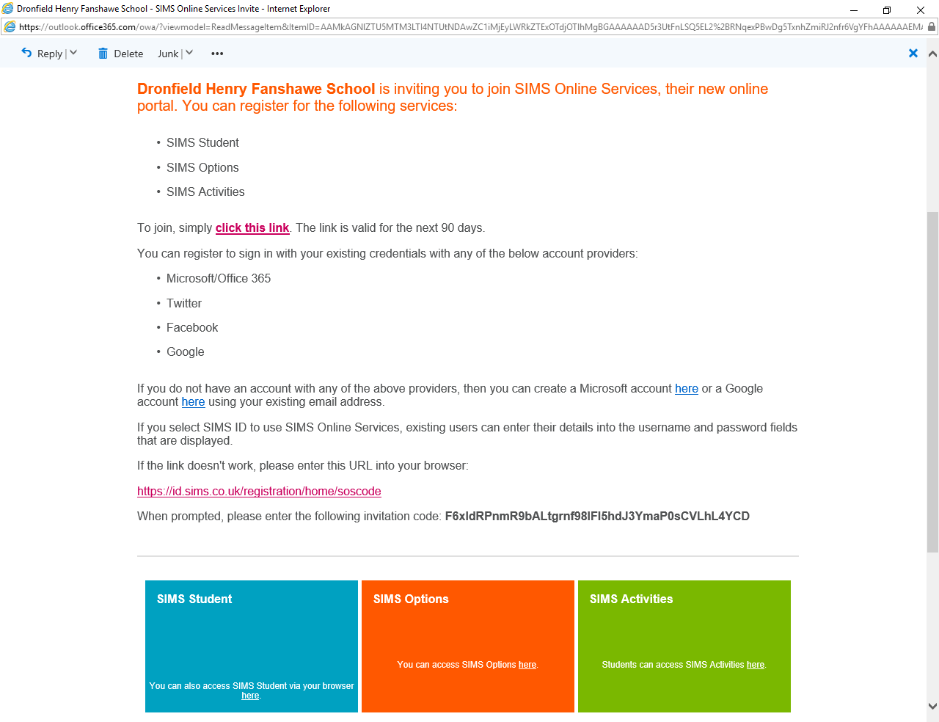
Notes:
This is what we expect, OUR commitment to you and your parents/carers, this is our day to day business. Committed staff body. Vast majority of our students contribute positively to achieving this

Slide 4
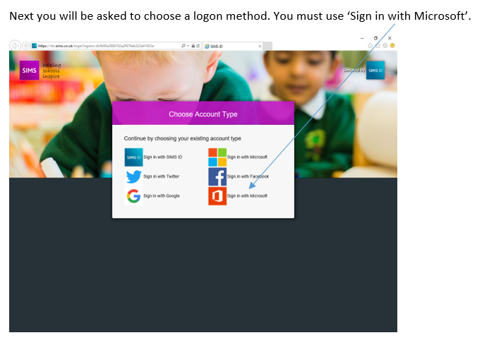
Notes:
This is what we expect, OUR commitment to you and your parents/carers, this is our day to day business. Committed staff body. Vast majority of our students contribute positively to achieving this

Slide 5
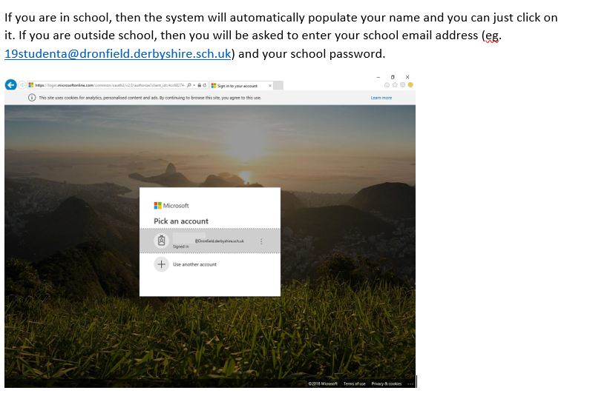
Notes:
This is what we expect, OUR commitment to you and your parents/carers, this is our day to day business. Committed staff body. Vast majority of our students contribute positively to achieving this

Slide 6
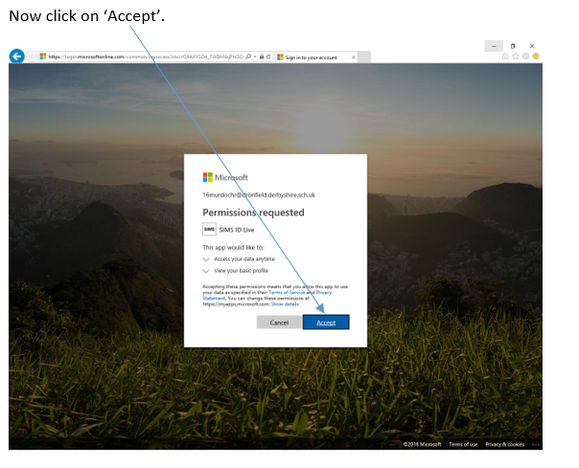
Notes:
This is what we expect, OUR commitment to you and your parents/carers, this is our day to day business. Committed staff body. Vast majority of our students contribute positively to achieving this

Slide 7
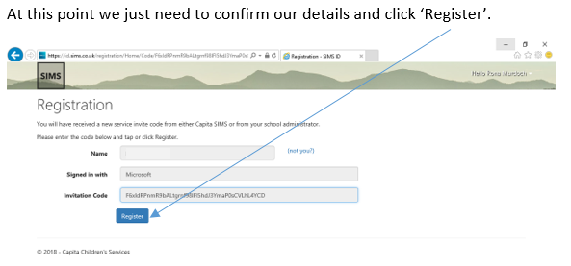
Notes:
This is what we expect, OUR commitment to you and your parents/carers, this is our day to day business. Committed staff body. Vast majority of our students contribute positively to achieving this

Slide 8
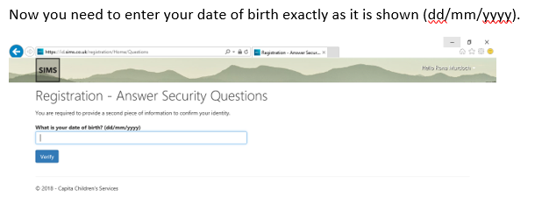
Notes:
This is what we expect, OUR commitment to you and your parents/carers, this is our day to day business. Committed staff body. Vast majority of our students contribute positively to achieving this

Slide 9
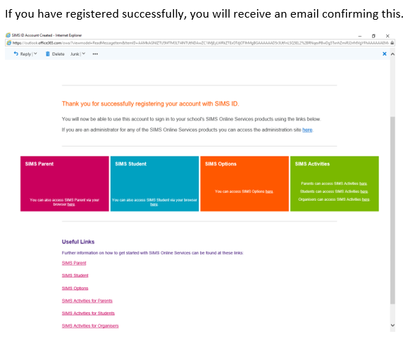
Notes:
This is what we expect, OUR commitment to you and your parents/carers, this is our day to day business. Committed staff body. Vast majority of our students contribute positively to achieving this

Slide 10
Getting started

Slide 11
If you are logging on via the school wireless network you must choose DHFS-BYOD. Any other connection may result in your connection being unstable. The App must be connected to WiFi or 4G to work correctly.
For Android users, you need to complete the following information:
Identity – Your school username in the following format “Dronfield\username”.
Password – You school password.
CA Certificate – Do not validate
Click save and you’re done.
For Apple users:
Username - Your school username in the following format “Dronfield\username”.
Password – Your School Password.
Click the JOIN button.
TRUST the certificate and you’re done.

Slide 12
You now have been successfully logged on to the Student SIMS area.
Starting on the 24th June all Homework in school will be set electronically.
That means rather than you writing your homework down in your planner your teacher will write the homework and you will log on to view it and then complete it as instructed.

Slide 13
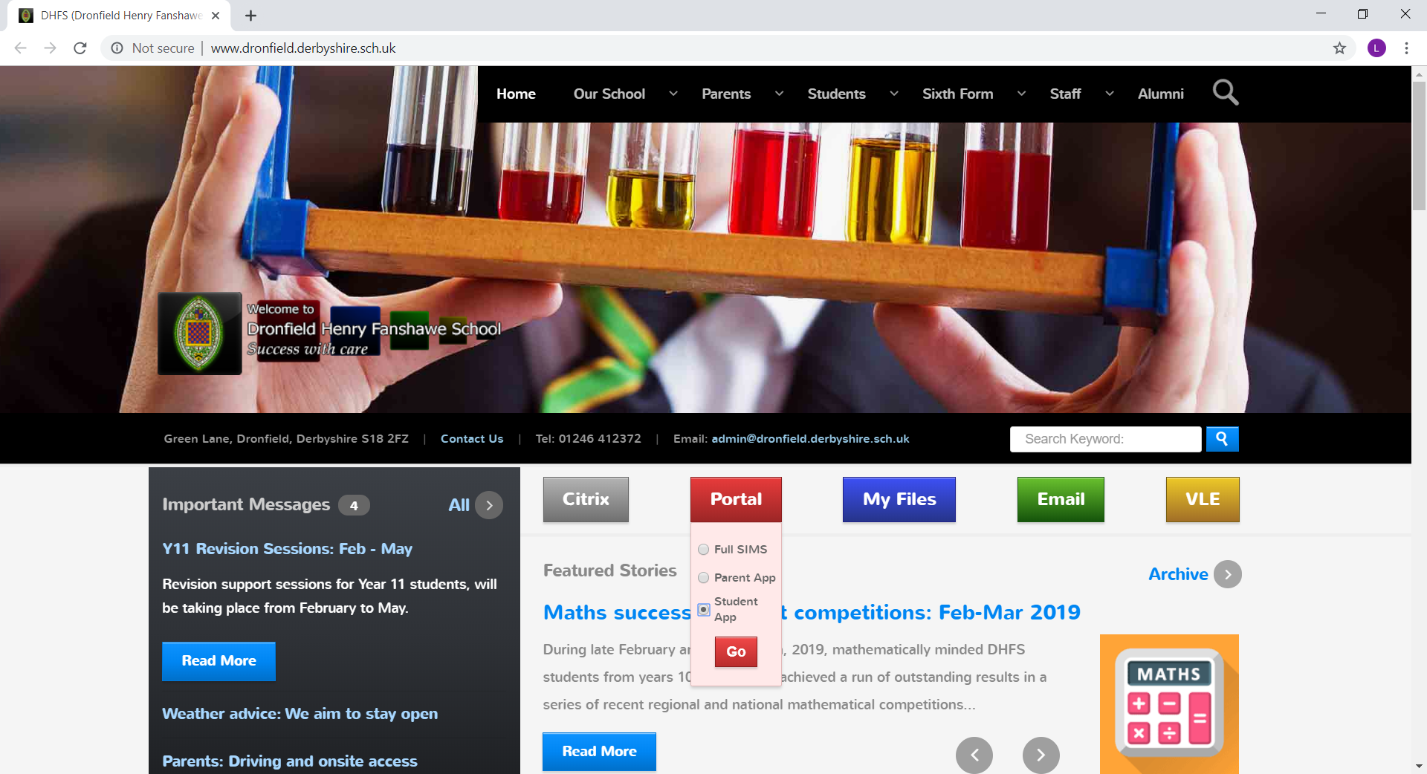
How will I view my homework?
To view your homework you have 2 options:
Click on the School website
Portal
-Student App
..and then simply log on with the log on details you have just completed.
OR……..

Slide 14
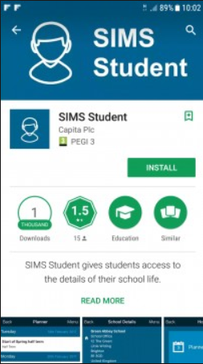
How will I view my homework?
Download the SIMS Student app on your phone/electronic device

Slide 15
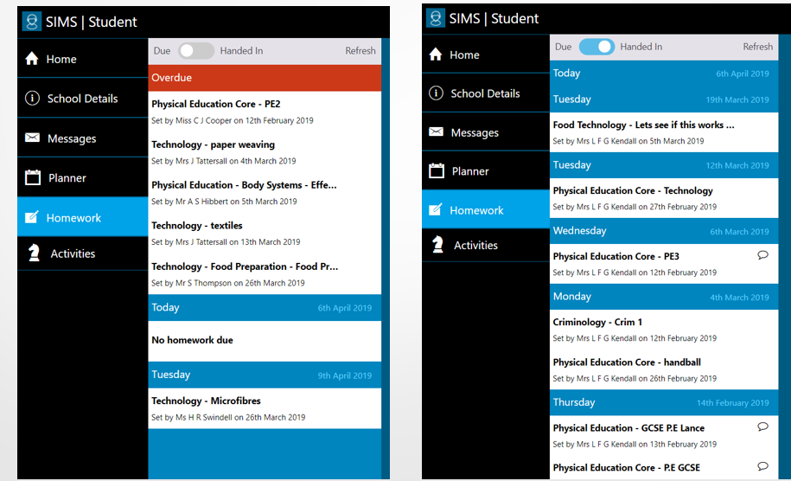
What will I see
Homework Due
Homework handed in
By clicking on the homework you will see:
what the homework is
Who it has been set by
Due Date

Slide 16
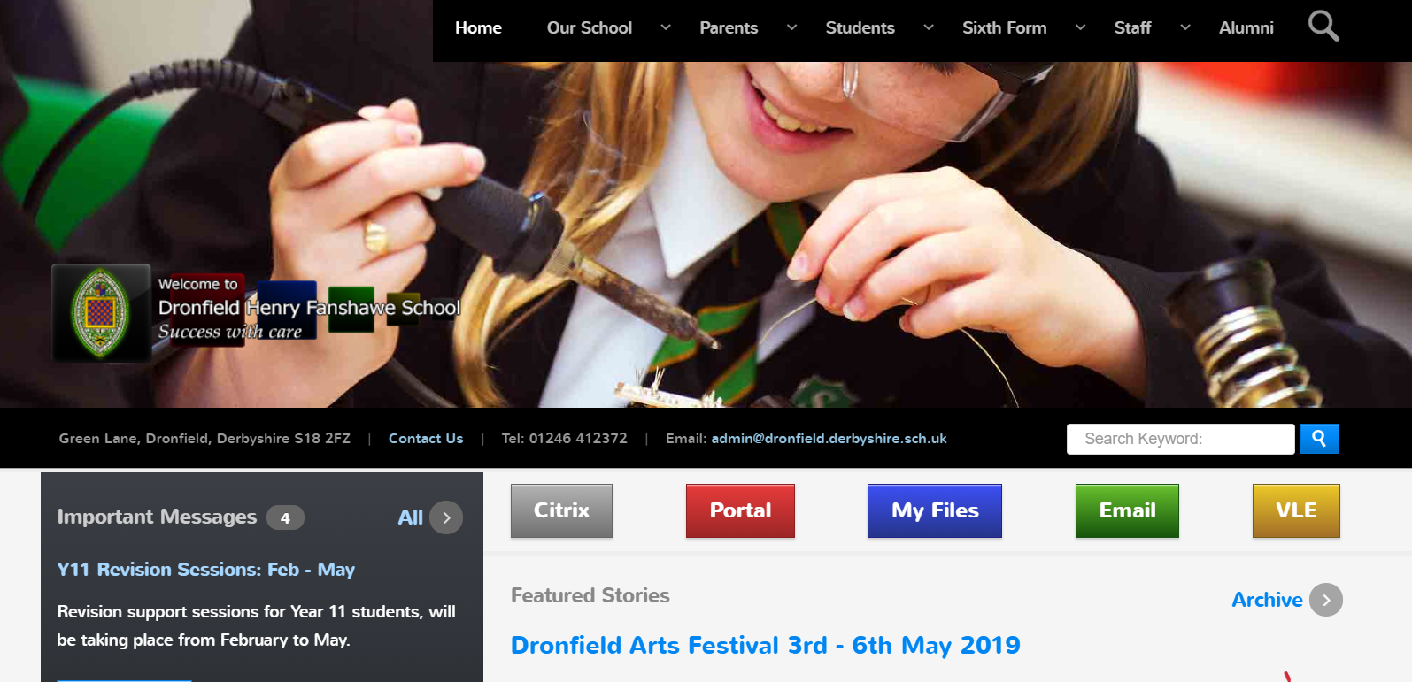
Key Points to Remember
Any additional sheets you may need to see to assist you with your homework will not be attached to the homework set but will be saved in the VLE.

Slide 17
Homework – Download the SIMS student app on your phone.
Record your username and password in your planner

